Slide 1

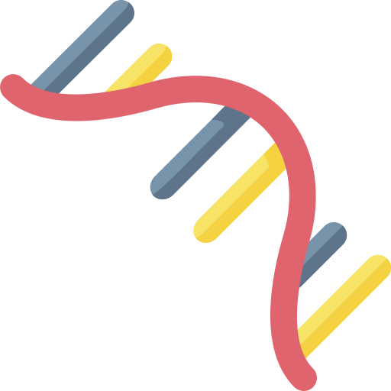
Gel electrophoresis is a procedure that separates nucleic acid fragments by size.
In what situations would scientists want to know the length of their nucleic acid samples?
Make sure PCR or DNA/RNA extractions worked properly
Quality check samples before sequencing them
“Do my nucleic acid samples look the way they should?”
DNA
RNA

Slide 2

Gel electrophoresis operates on the fact that nucleic acids are negatively charged.
Which way will this DNA sample move if exposed to an electrical current?
Power source
Negative electrode
Positive electrode
Nucleic acids “run to red.”

Slide 3
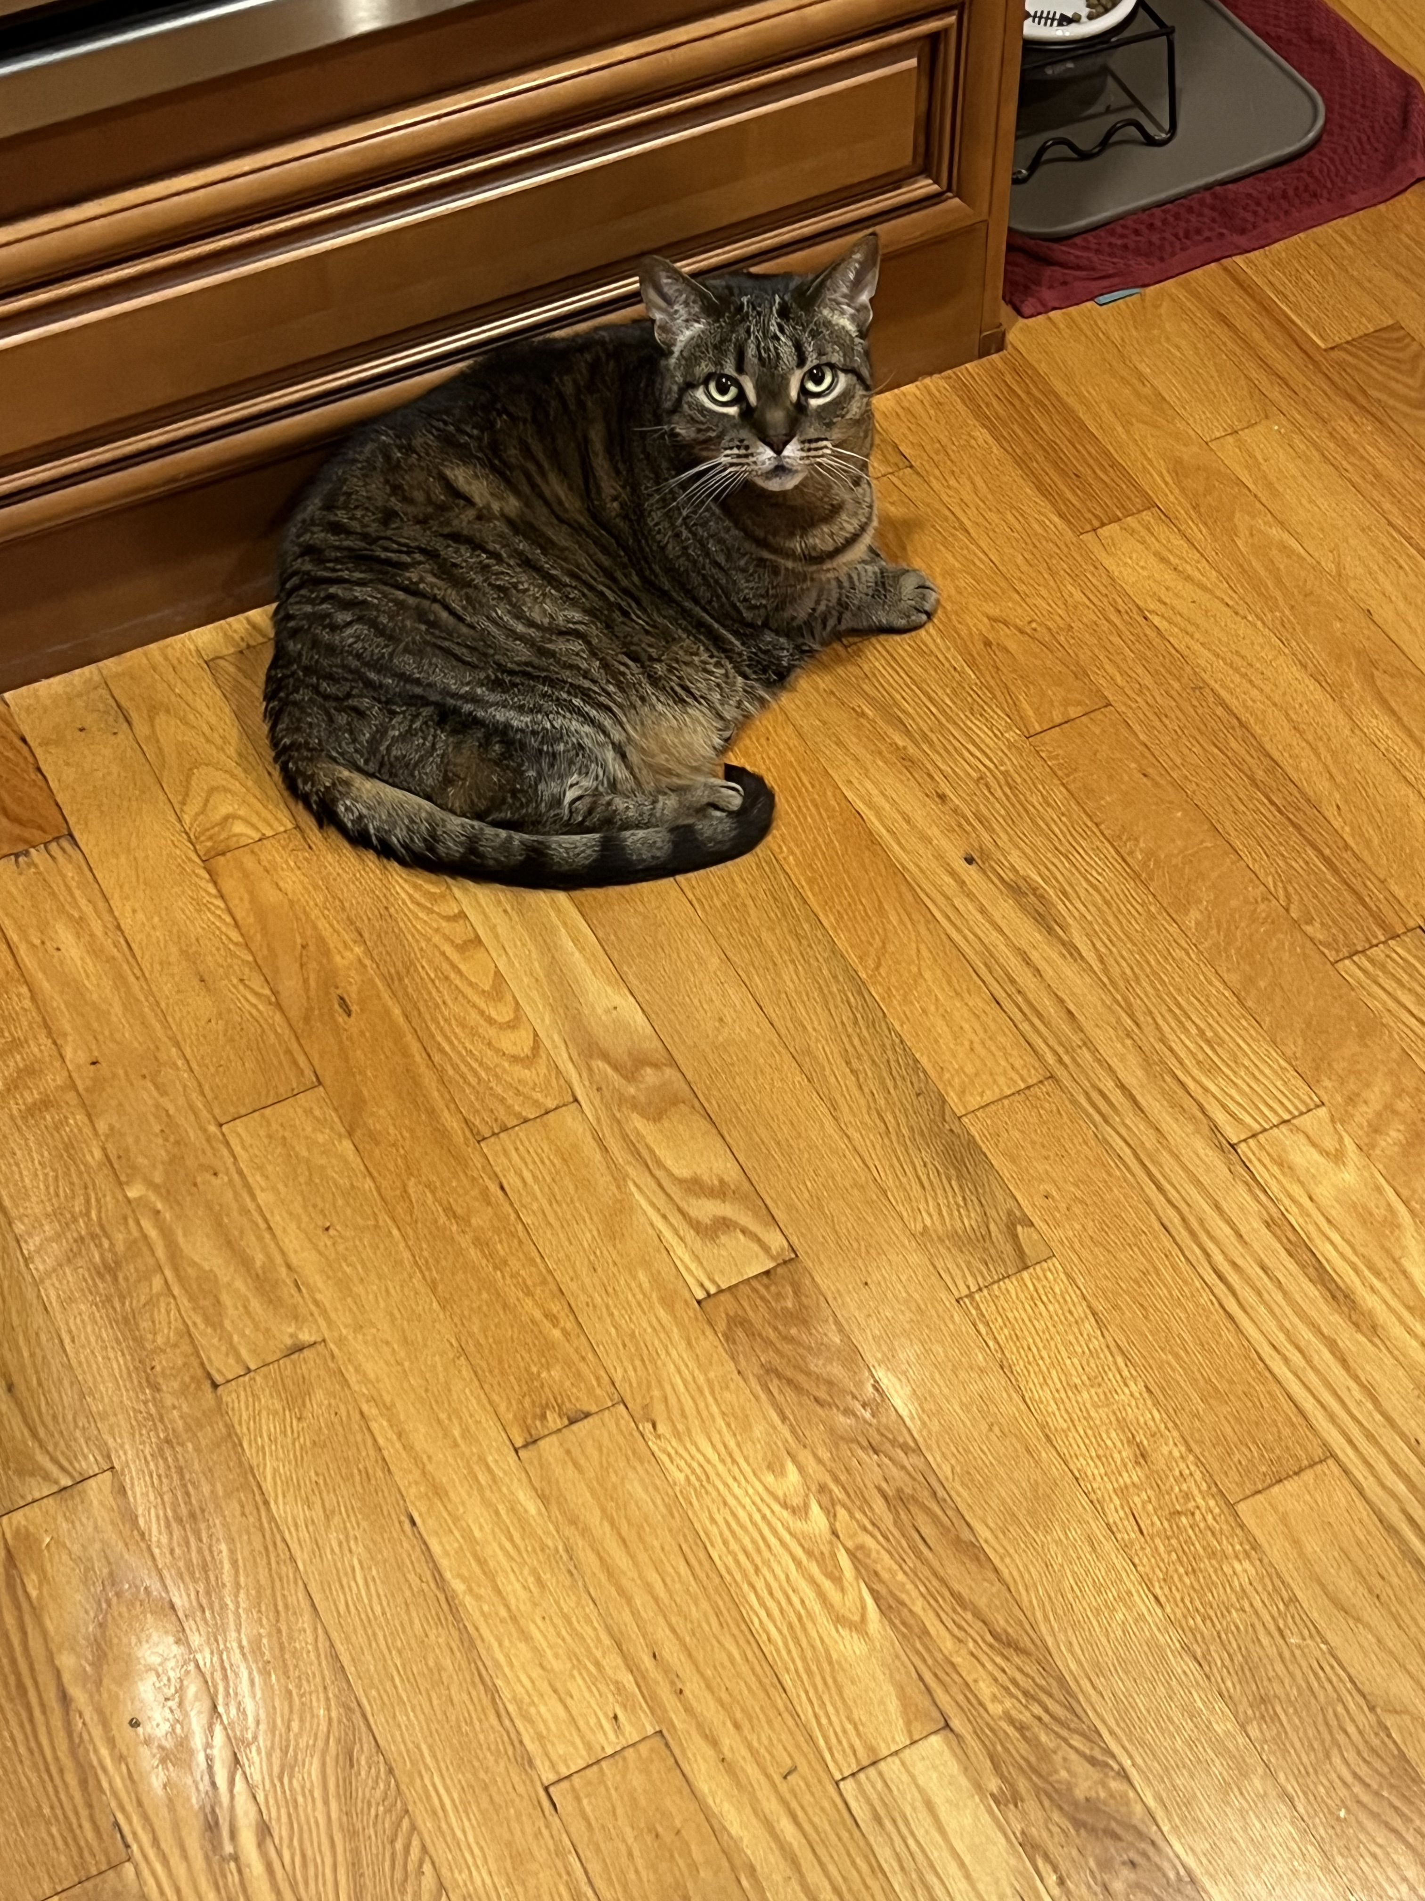
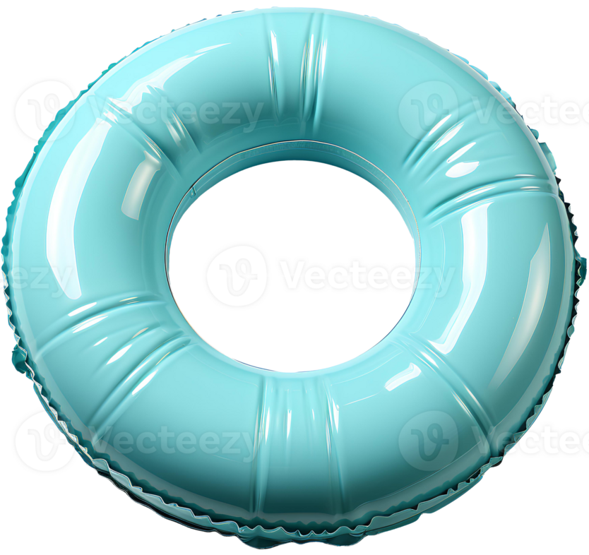
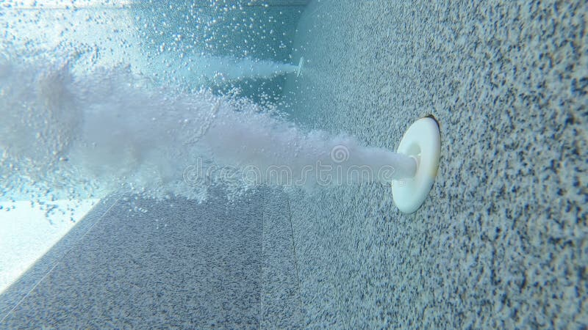
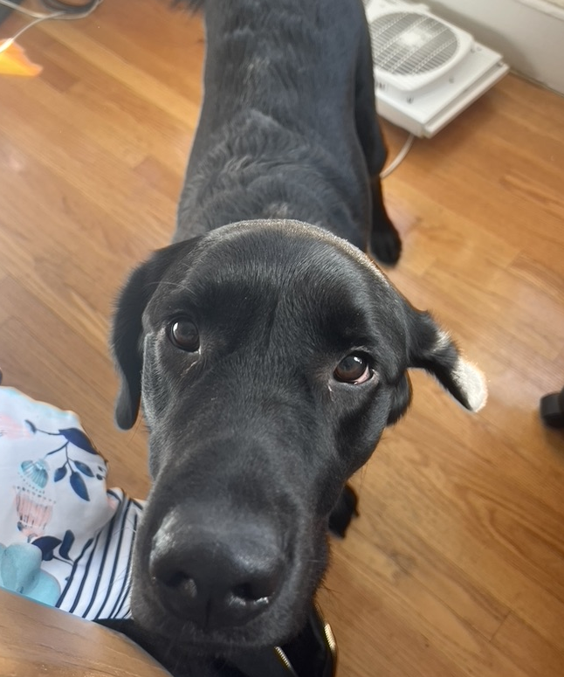
Imagine a swimming pool with two objects of unequal size.
Nutmeg: 15 pounds
Gremlin: 70 pounds
Water current direction

Slide 4
Gel electrophoresis follows the same logic: smaller DNA samples move farther than larger when equal force is exerted.
Power source
Negative electrode
Positive electrode

Slide 5
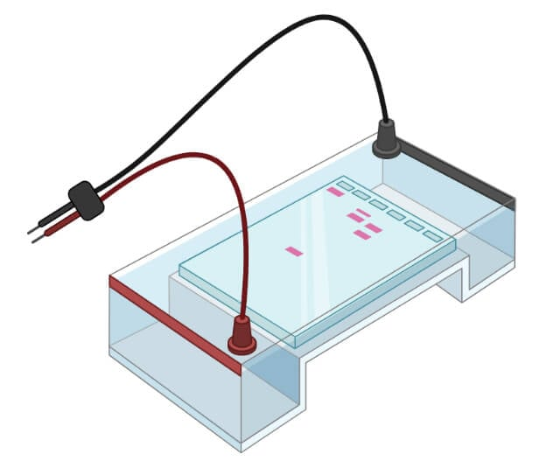
Grey’s Gel’s Anatomy
Negative electrode (”cathode”)
Sample wells (divots in gel)
DNA travels
Buffer (conductive liquid)
Connected to power supply
Dyed nucleic acid samples
Gel box
Positive electrode (”anode”)
Agarose gel (Jello-like structure that nucleic acids can move through)

Slide 6
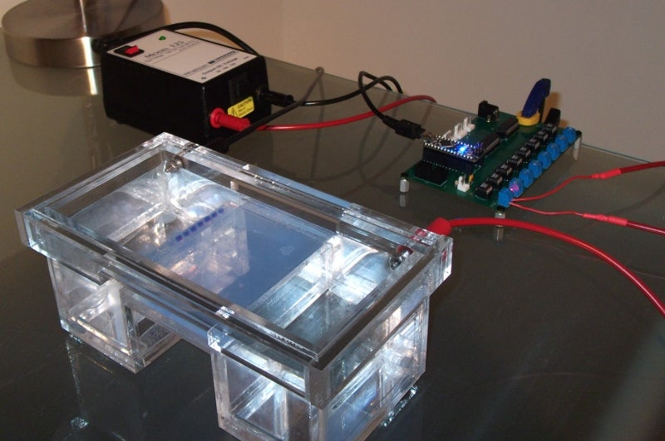
In practice
Photo: Instructables.com

Slide 7
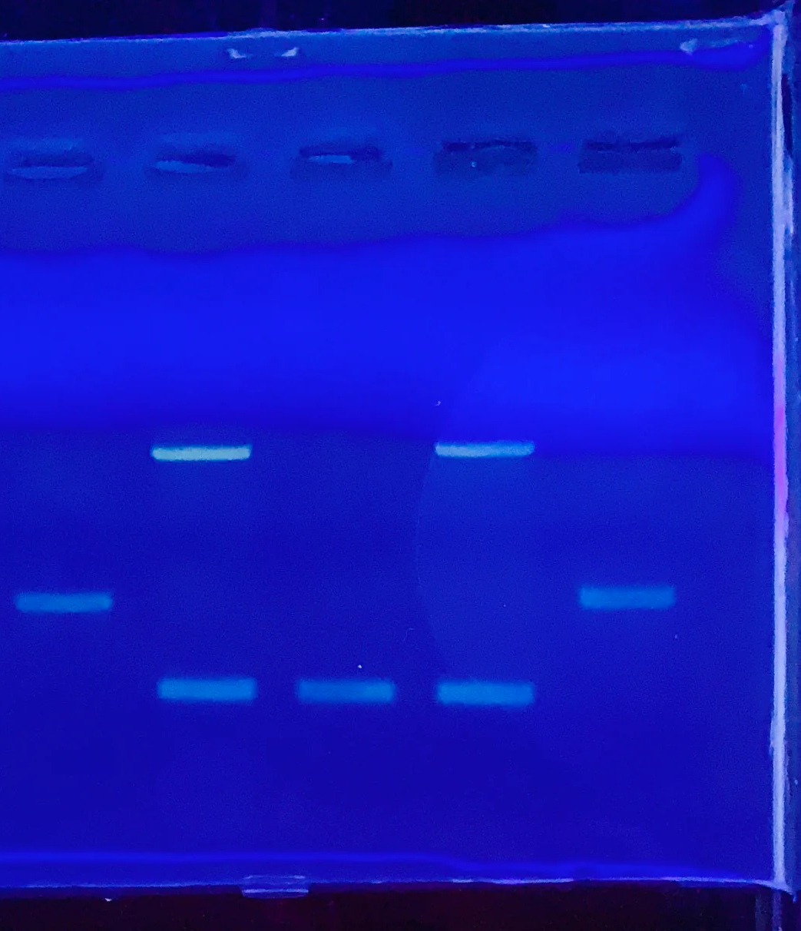
The Big Reveal: Reading Results
The current runs through the gel for 20-30 minutes
The dye used to stain samples glows under UV light
After a run, illuminate the gel with UV light to see the “bands” of each sample.

Slide 8
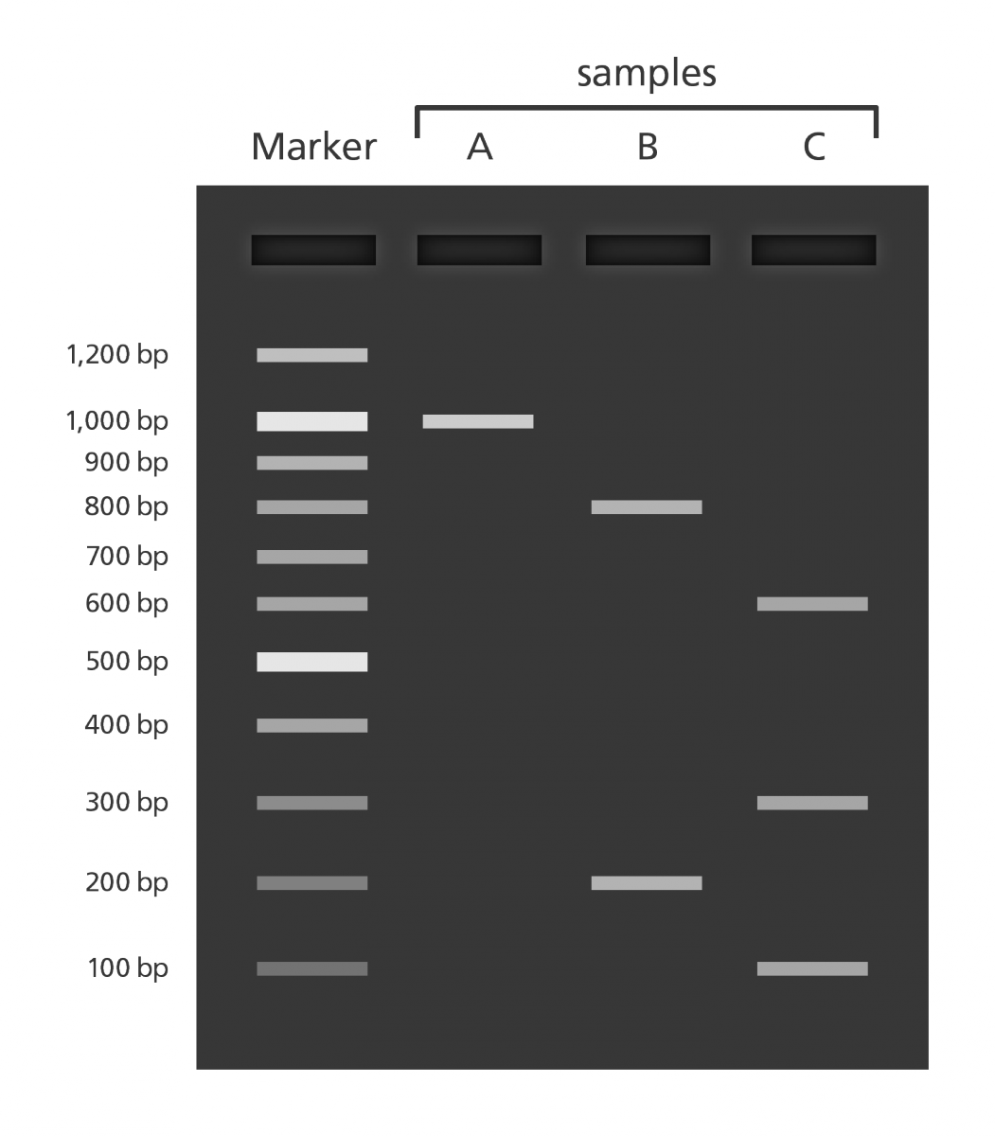
Knowledge check!
Which sample is the longest?
Sample A
Which sample is the shortest?
Sample B
In which direction did the samples move?
Top-to-bottom
Where was the positive electrode (anode)?
Bottom

Slide 9
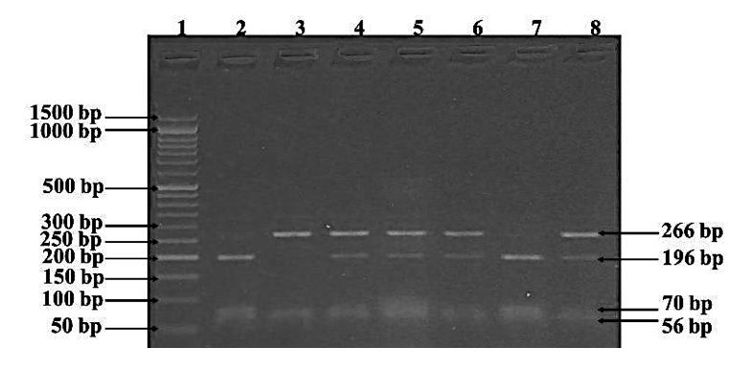
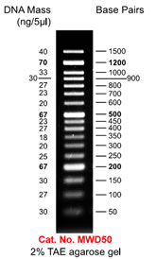
How could we find out how many base pairs long each sample is?
Introducing… the ladder!
Purchased from a manufacturer
Contains samples of several known lengths that can be run on a gel
Comes with a key to show you which bands are which lengths

Slide 10
Knowledge check!
About how long is each sample?
Sample A: 1000 base pairs (bp)
Sample B: 200 bp
Sample C: 600 bp

